Slide 1


MEMBER EXPERIENCE FORECASTING TOOL KICK OFF MEETING

Slide 2

| AGENDA
INTRODUCTIONS
SCOPE OVERVIEW
SCHEDULE
NEXT STEPS
Q & A

Slide 3
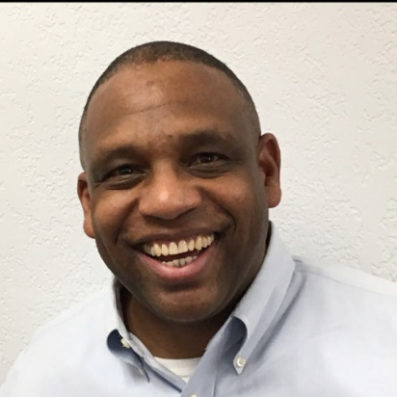



INTERVISION Team
DELIVERY TEAM Orrin Fiandaca – Senior Software Engineer Ahmet Kaya – Senior Data Scientist Alan Luu – Data Scientist James Decker – Data Scientist Ananth Gopalakrishnan – Senior Data Scientist Corey Hadden – Quality Assurance
Ken White
PROJECT MANAGER
Harsha Gopianandan
DELIVERY EXECUTIVE
Dallas Brown
PROJECT MANAGEMENT SUPPORT
Michael Henry
LEAD ARCHITECT

Slide 4
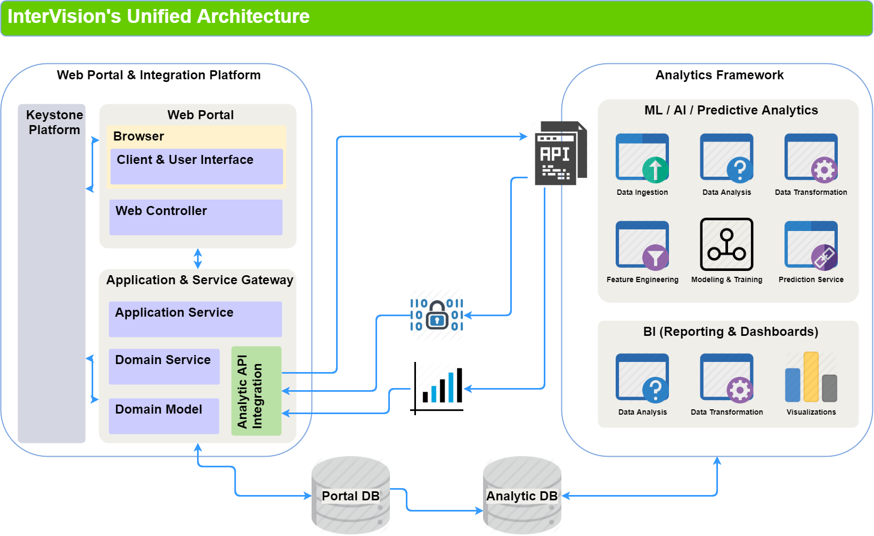
SCOPE Overview

Slide 5
Project schedule March 18, 2020 – July 24, 2020
Phase | Dates | High Level Activities
Sprint 0 | March 18 – April 3 | Project Kick Off and initiation
Sprint 1 | April 6 – May 1 | Base Portal Application Exploratory data analysis completed Reporting / dashboarding tasks 25% completed
Sprint 2 | May 4 – May 29 | Base Integration / Structure Reporting / dashboarding tasks 50% completed Machine learning model initial development completed Forecasting / prediction tasks 30% completed
Sprint 3 | June 1 – June 26 | Integration of 16-20 of the data sources implemented Reporting / dashboarding tasks 75% completed Forecasting / prediction tasks 60% completed
Sprint 4 | June 29 – July 24 | Integration of remaining 12-16 of the data sources implemented All analytics tasks completed Final polish Delivery to UAT

Slide 6
NEXT STEPS
Complete Requirements Review and Validation Sessions
Set up development environment
Schedule biweekly status meetings with BSC team – 30 minutes sessions
Set up document collaboration site with BSC team

Slide 7
QUESTIONS

